Slide 1
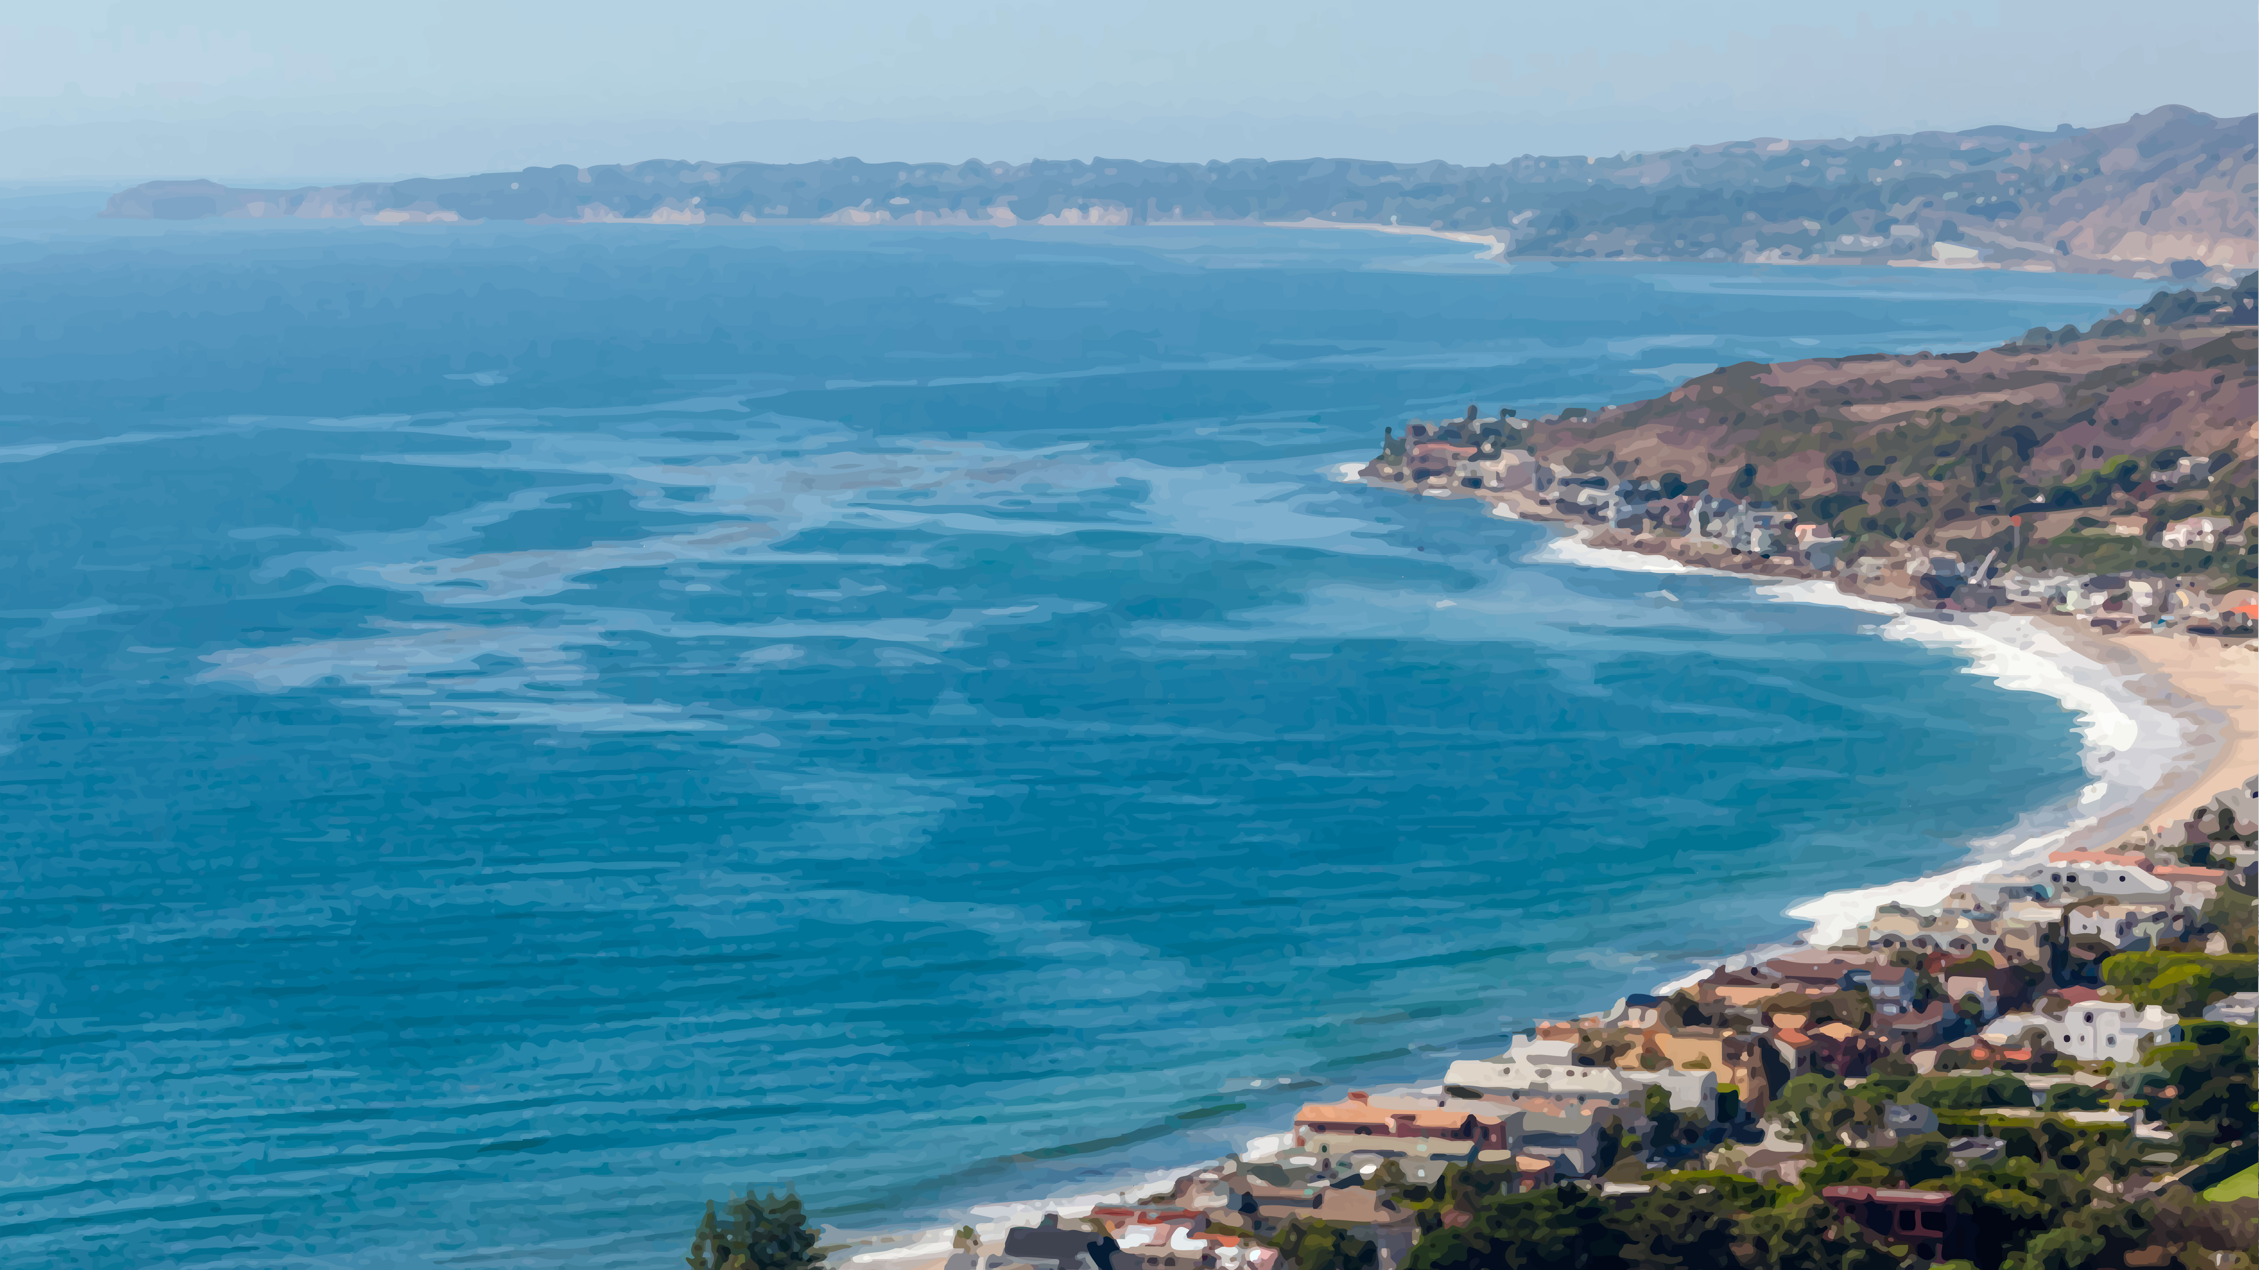
Malibu Civic Center
Water Treatment Facility
Phase Two
Community Update Meeting
September 17, 2020

Slide 2

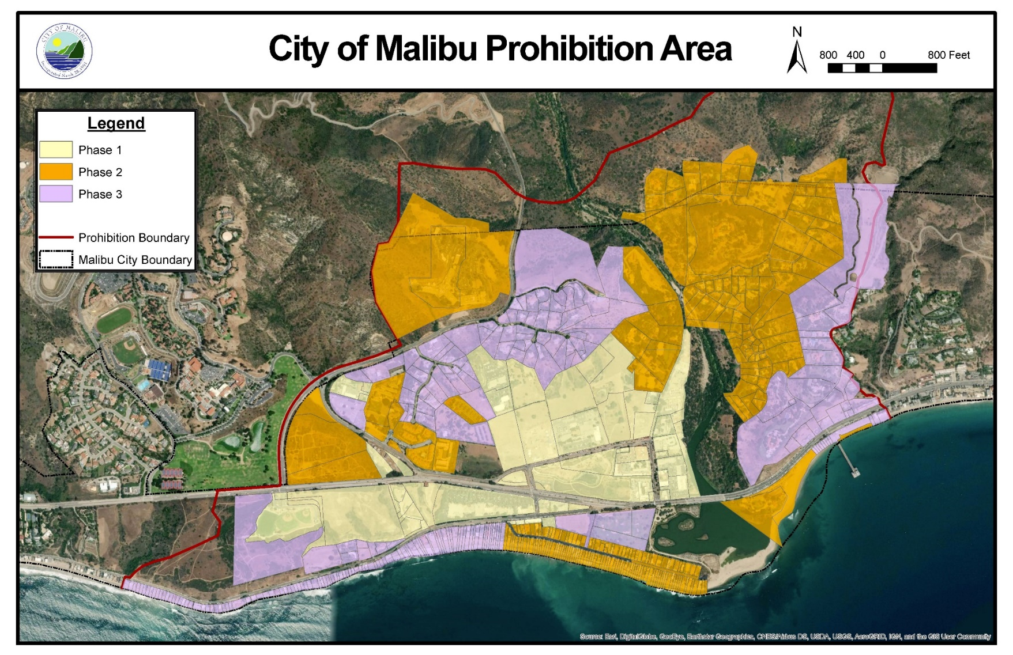
Phase 1 - Complete
Phase 2 - 2024
Phase 3 - 2028

Slide 3
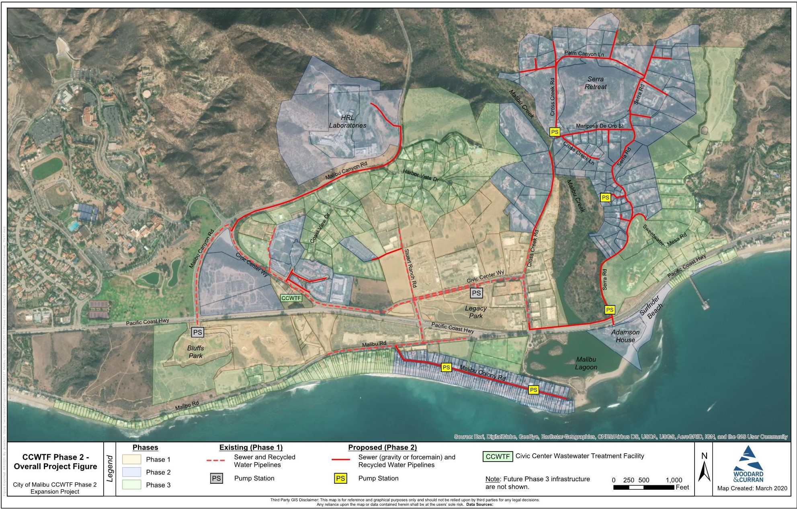
General Project Overview

Slide 4
Phase Two Information
448 properties
  240 residential homes
  191 condominiums
  17 other properties
General Areas:
  Serra
  Malibu Colony
  HRL
  Adamson House and Surfrider Beach
  Condominiums on Civic Center Way, De Ville Way, and Vista Pacifica
Estimated Cost: $45 million

Slide 5
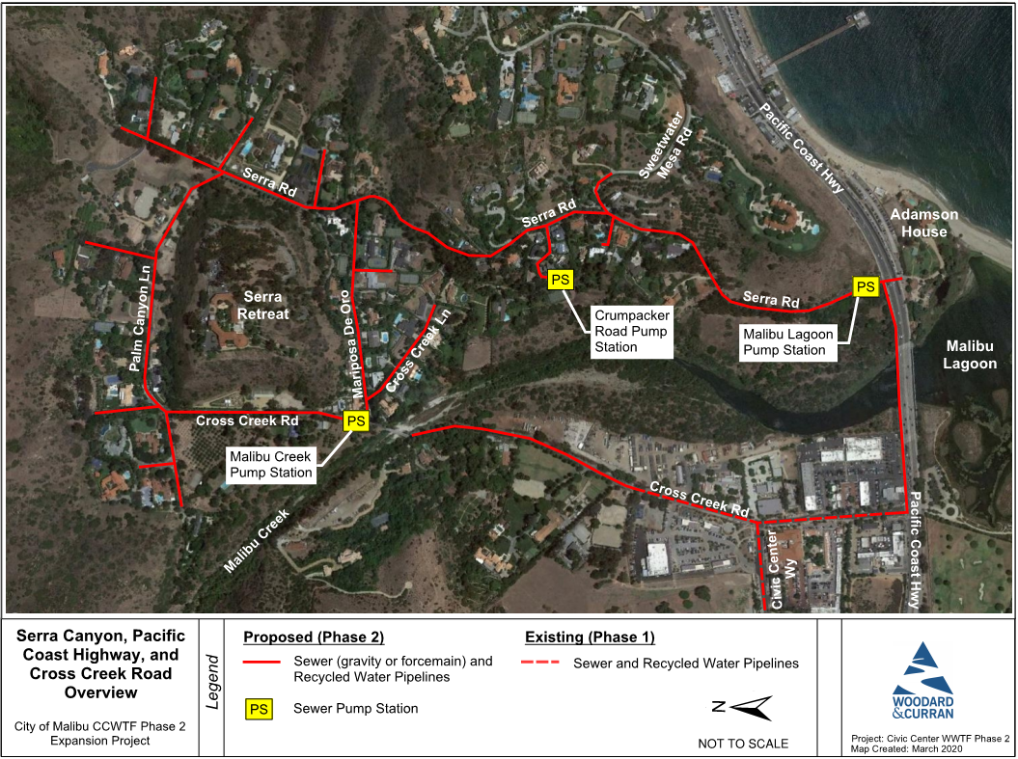
Serra, PCH, and Cross Creek Road Overview

Slide 6
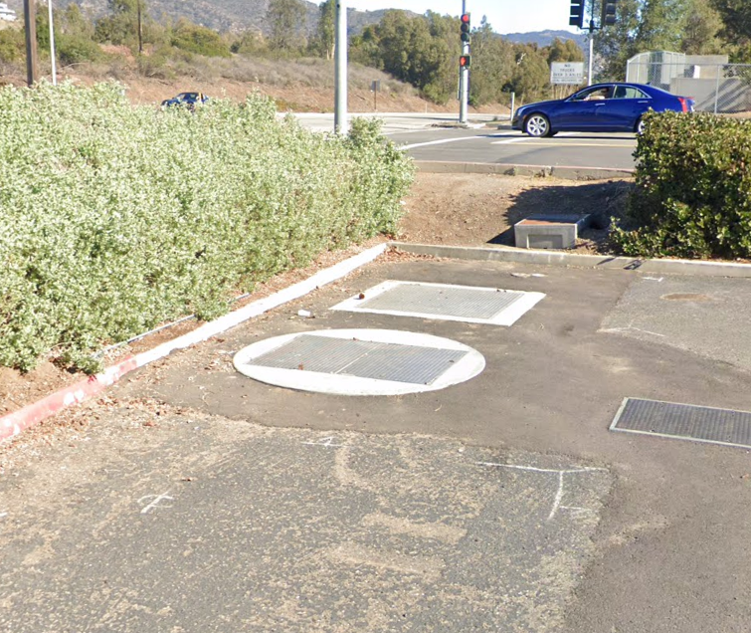
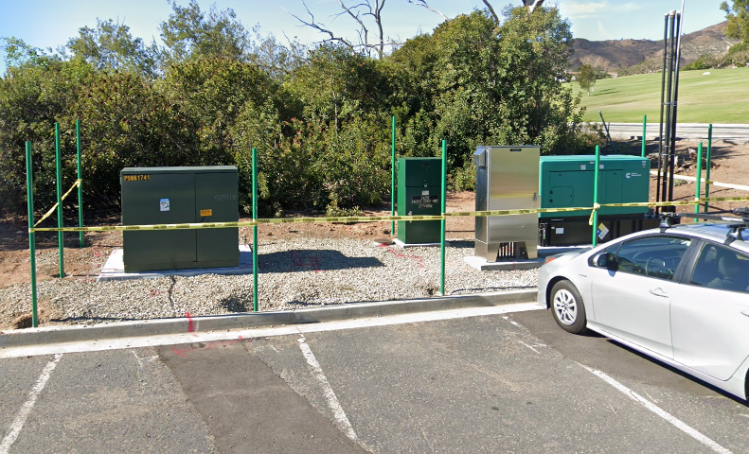
Existing Bluffs Park Pump Station
Underground Valve Vault
Underground Wetwell with Pumps
Pump Station Electrical

Slide 7
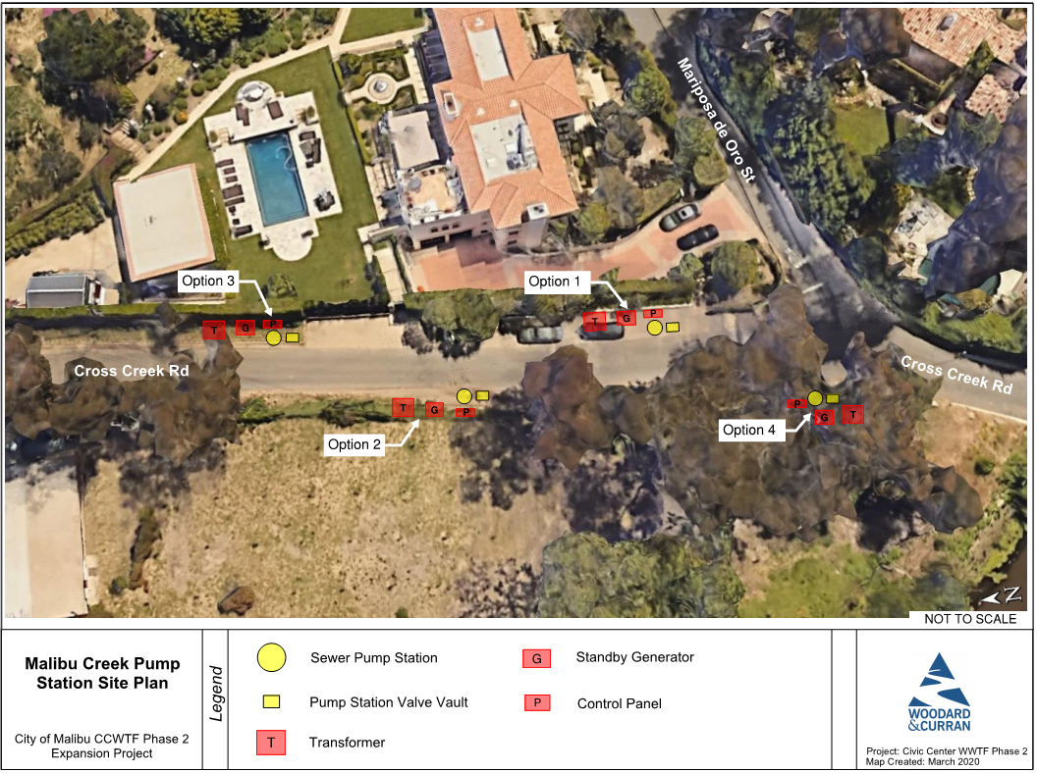
Proposed Malibu Creek Pump Station Locations

Slide 8
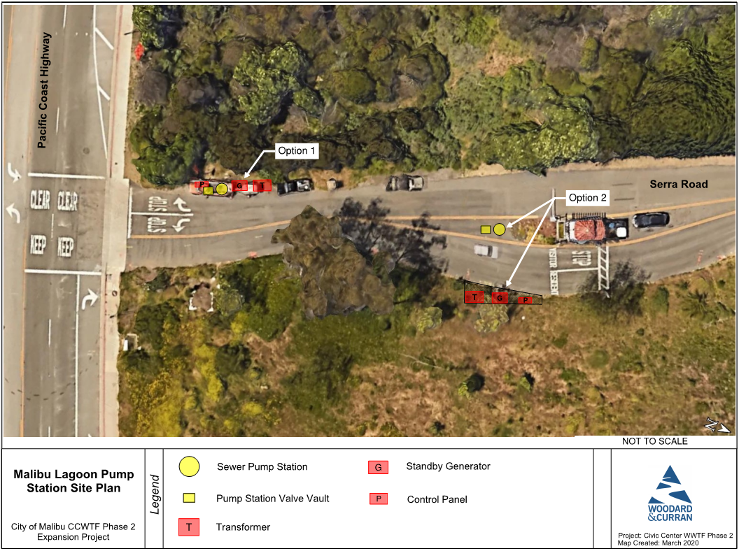
Proposed Malibu Lagoon Pump Station Location

Slide 9
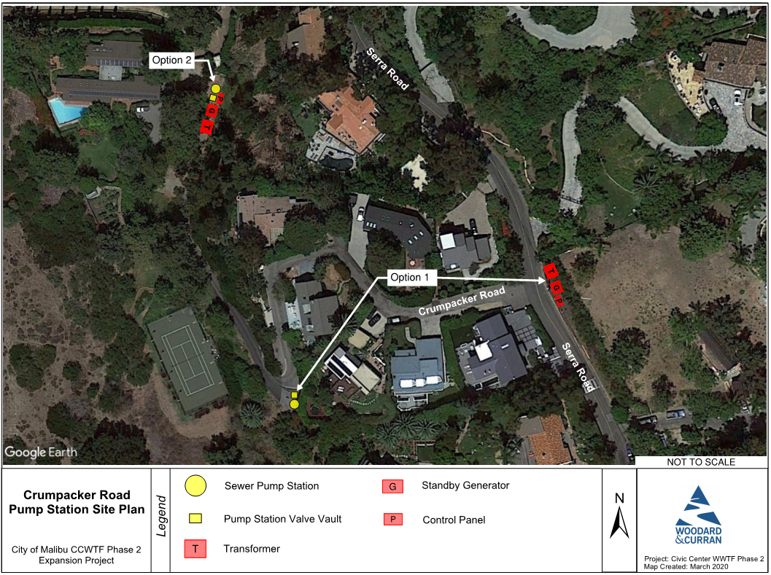
Proposed Crumpacker Pump Station Location

Slide 10
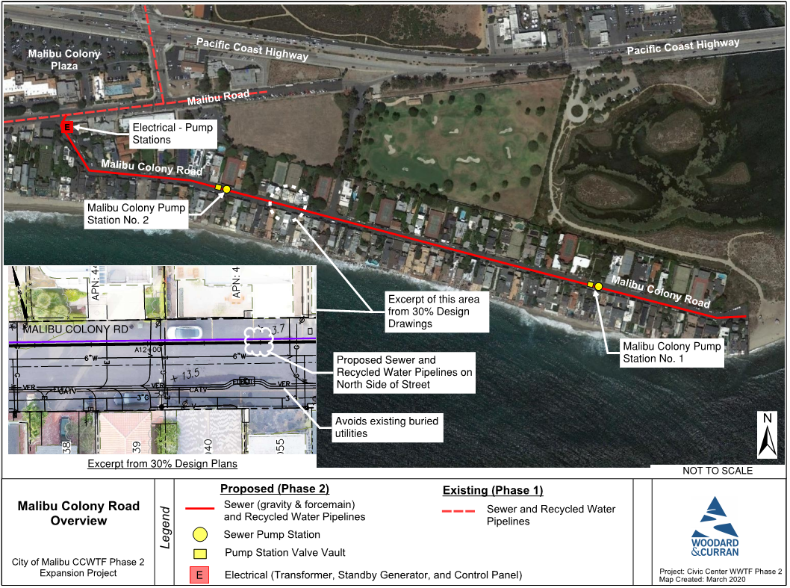
Malibu Colony Road Overview

Slide 11
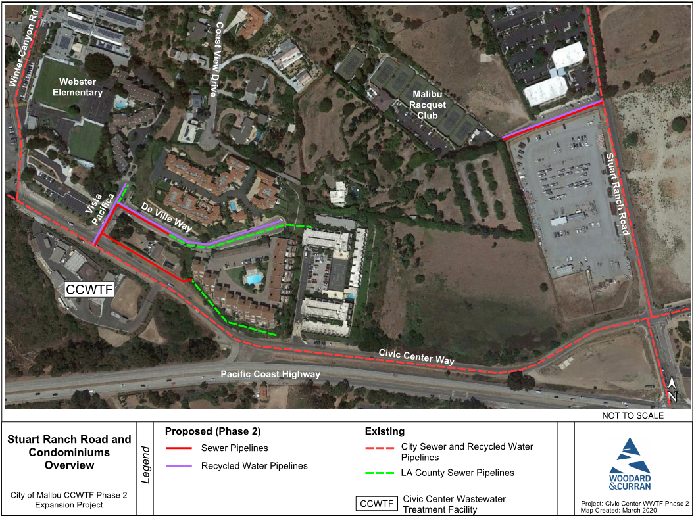
Stuart Ranch Road and Condominiums Overview

Slide 12
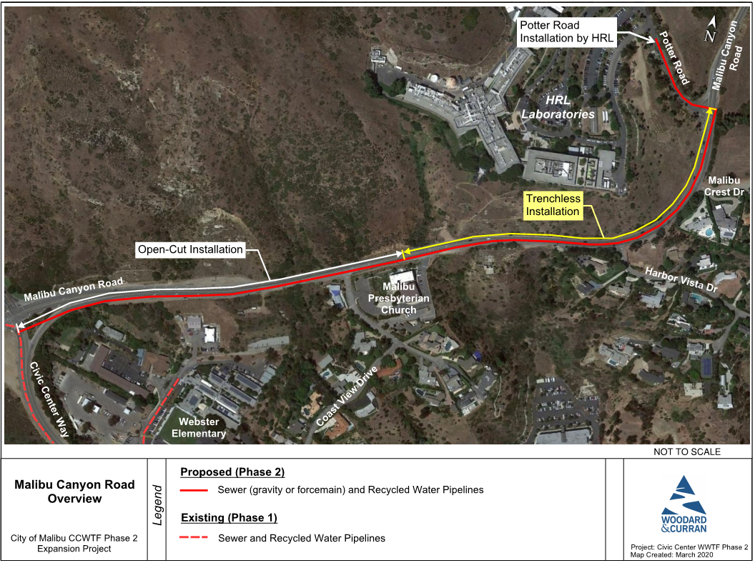
Malibu Canyon Road Overview

Slide 13
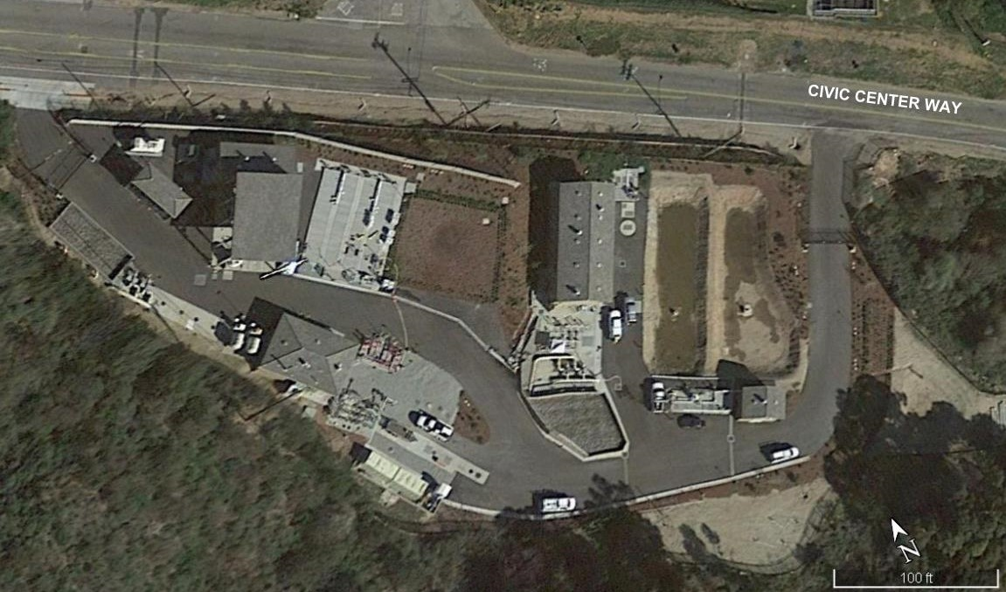
Civic Center Water Treatment Facility Expansion
All treated flow in compliance with permit requirements
Phase One capacity is 191,000 gallons per day
  Commercial
Phase Two capacity will expand to 360,000 gallons per day
  Residential
  HRL
Aerial Image of Civic Center Water Treatment Facility

Slide 14
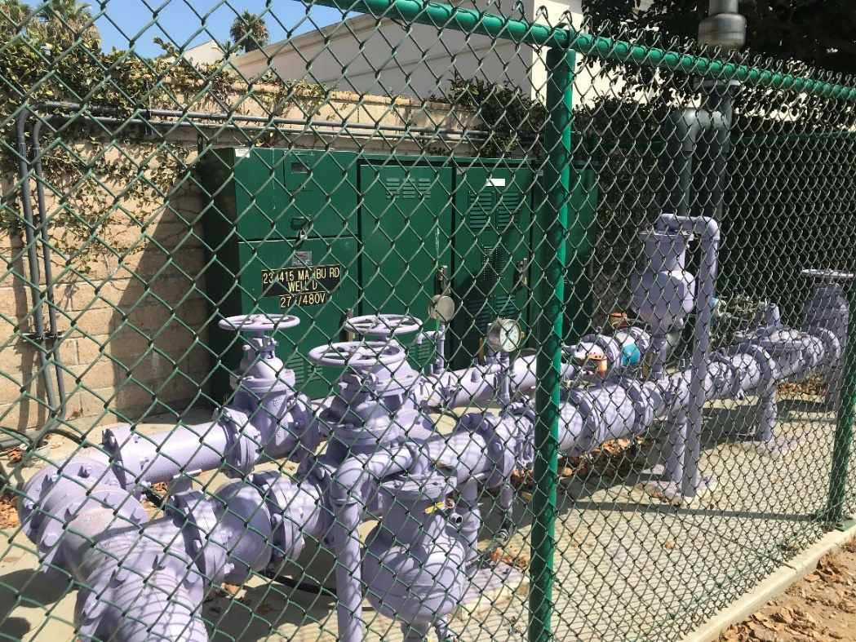
Injection Wells – Malibu Road
Injection Wells for disposal of excess recycled water
Three wells installed in Phase One
  Two wells completed and functioning
  Third well will be upgraded and utilized with Phase Two
Injection Well along Malibu Road

Slide 15
Phase Two Timeline

Slide 16
2020 Stakeholders Meetings
Project Funding
Phase One
  Costs $60.1 million
Phase Two
  Estimated costs $45 million
  Cost per property will be developed during the Assessment District Formation
Potential State Funding Programs
  State Revolving Loan
  Clean Water Grants
Assessment District Formation
  Cost per property placed on property taxes
  Costs will be spread out for approximately 30 years

Slide 17
2020 Stakeholders Meetings
Property Owner Requirements
Wastewater Lateral Connection
  Property owner to connect private wastewater lateral to wastewater collection system
  Property owner responsible for the cost of the private lateral and decommission of private onsite wastewater system
  Required to connect by November 2024
Assessment District
  Special election vote
Recycled Water Use
  Special requirements for property owners to use recycled water
    Permit with the City
    Annual inspections with the County
    Other onsite improvements

Slide 18
2020 Stakeholders Meetings
City Requirements
Design
  Complete 65% Design for Sewer and Recycled Water Systems by end of November
    Complete field geotechnical investigations by end of October
    Apply for an encroachment Permit application to Caltrans for PCH bridge
Assessment District Formation
  City to hire Assessment District Engineer by November
CEQA
  Finalize Addendum to 2014 Programmatic Environmental Impact Report for Phase 2 Project
  Certify Addendum by March 31, 2021 (Regional Board MOU deadline)
Prepare State Revolving Loan Application for SWRCB
Next Stakeholder Meeting in December

Slide 19
Additional information available at
MalibuCity.org/CCWTF

Slide 20
Back Up Slides

Slide 21
Phase One Summary
All developed properties are now connected, including all City-owned properties
Remaining properties are undeveloped
Currently treating an average flow of 50,000 – 70,000 gallons per day
All treated flow has been in compliance with permit requirements
Approximately 32,000 linear feet (6 miles) of wastewater and recycled water lines were installed
Currently supplying 47,500 – 66,500 gallons per day of recycled water
Phase One Cost: $60.1 million

Slide 22
2020 Stakeholders Meetings
2020 Stakeholders Meetings
February 4, 2020 – Serra Canyon Property Owners Association
February 11, 2020 – Malibu Colony HOA
April 16, 2020 - Community meeting cancelled due to COVID-19
  Information packet provided in lieu of meeting
April 28, 2020 – Adamson House and Surfrider Beach
July 28, 2020 – Serra Canyon Property Owners Association

Slide 23
Assessment District Formation and Bond Issuance
Scope of Work
Task 1 – Boundary Map and Assessment Diagram
Task 2 – Assessment Methodology
Task 3 – Financial Analysis
Task 4 – Engineer’s Report
Task 5 – AD Formation Document Review
Task 6 – Bond Issuance
Task 7 – Meetings and Teleconferences

Slide 24
Assessment District Administration
Scope of Work
Task 1 – Annual Installment Calculations
Task 2 – Assessment Billing and Collection
Task 3 – Trust Account Review
Task 4 – Property Owner Inquiries
Task 5 – Parcel Database
Task 6 – Reports
Task 7 – Assessment Apportionments and Amended Diagrams

