Slide 1

Malibu OWTS Practitioner Annual Meeting
Onsite Wastewater Treatment System Regulations:
Review of Codes
and Best Practices
Notes:
(YB) Good afternoon, and welcome to our annual OWTS Practitioner Meeting. I’m Yolanda Bundy, the Environmental Sustainability Director and Building Official for the City of Malibu. It’s been a pleasure working with all of you. Today, we’ll be discussing the City’s OWTS regulations, with a detailed review of the key codes and best practices. (next slide)

Slide 2
Agenda
Purpose
Meet the Team
Regulatory Framework Overview
OWTS Practitioner Requirements
OWTS Requirements
New Construction
OWTS Maintenance
New Codes and Updates
Best Practices
Q&A
Notes:
(YB) Let’s take a look at our agenda for today’s presentation. I’ll outline the primary goals of today’s meeting, so we know what to focus on and what we aim to achieve by the end of our session. We’ll start with an introduction of our Environmental team, then look at the regulatory framework required for our septic systems. Next, we’ll review the specific requirements and responsibilities for you as our OWTS practitioners. and for our septic systems. Then, we will discuss requirements for OWTS construction and maintenance. We will also provide an update on recent changes to our codes and regulations. We’ll talk about best practices. And lastly, we’ll open the floor for questions. I look forward to a productive session with you. Let’s get started! (next slide)

Slide 3
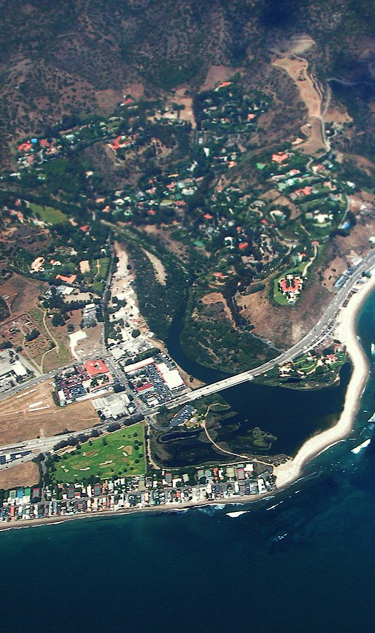
Purpose: What We Do
Essential Activities
Permitting, plan review, and oversight for onsite wastewater treatment systems (OWTS)
Review development projects for OWTS compliance with local coastal program requirements and state and local laws
Maintain OWTS as a sustainable method of sewage disposal
Protect public health and the environment
Notes:
(YB) The Wastewater Management Program administers permitting, plan review, and oversight programs for Onsite Wastewater Treatment Systems (or OWTS). Staff review development projects for OWTS compliance with the LCP, state and local laws. This Program strives to maintain OWTS as a sustainable method of sewage disposal within city limits where sewers are unavailable.
All in all, our Environmental Health team collaborates closely with you - our OWTS practitioners - to ensure that OWTS are properly maintained in order to protect public health and the environment.

Slide 4
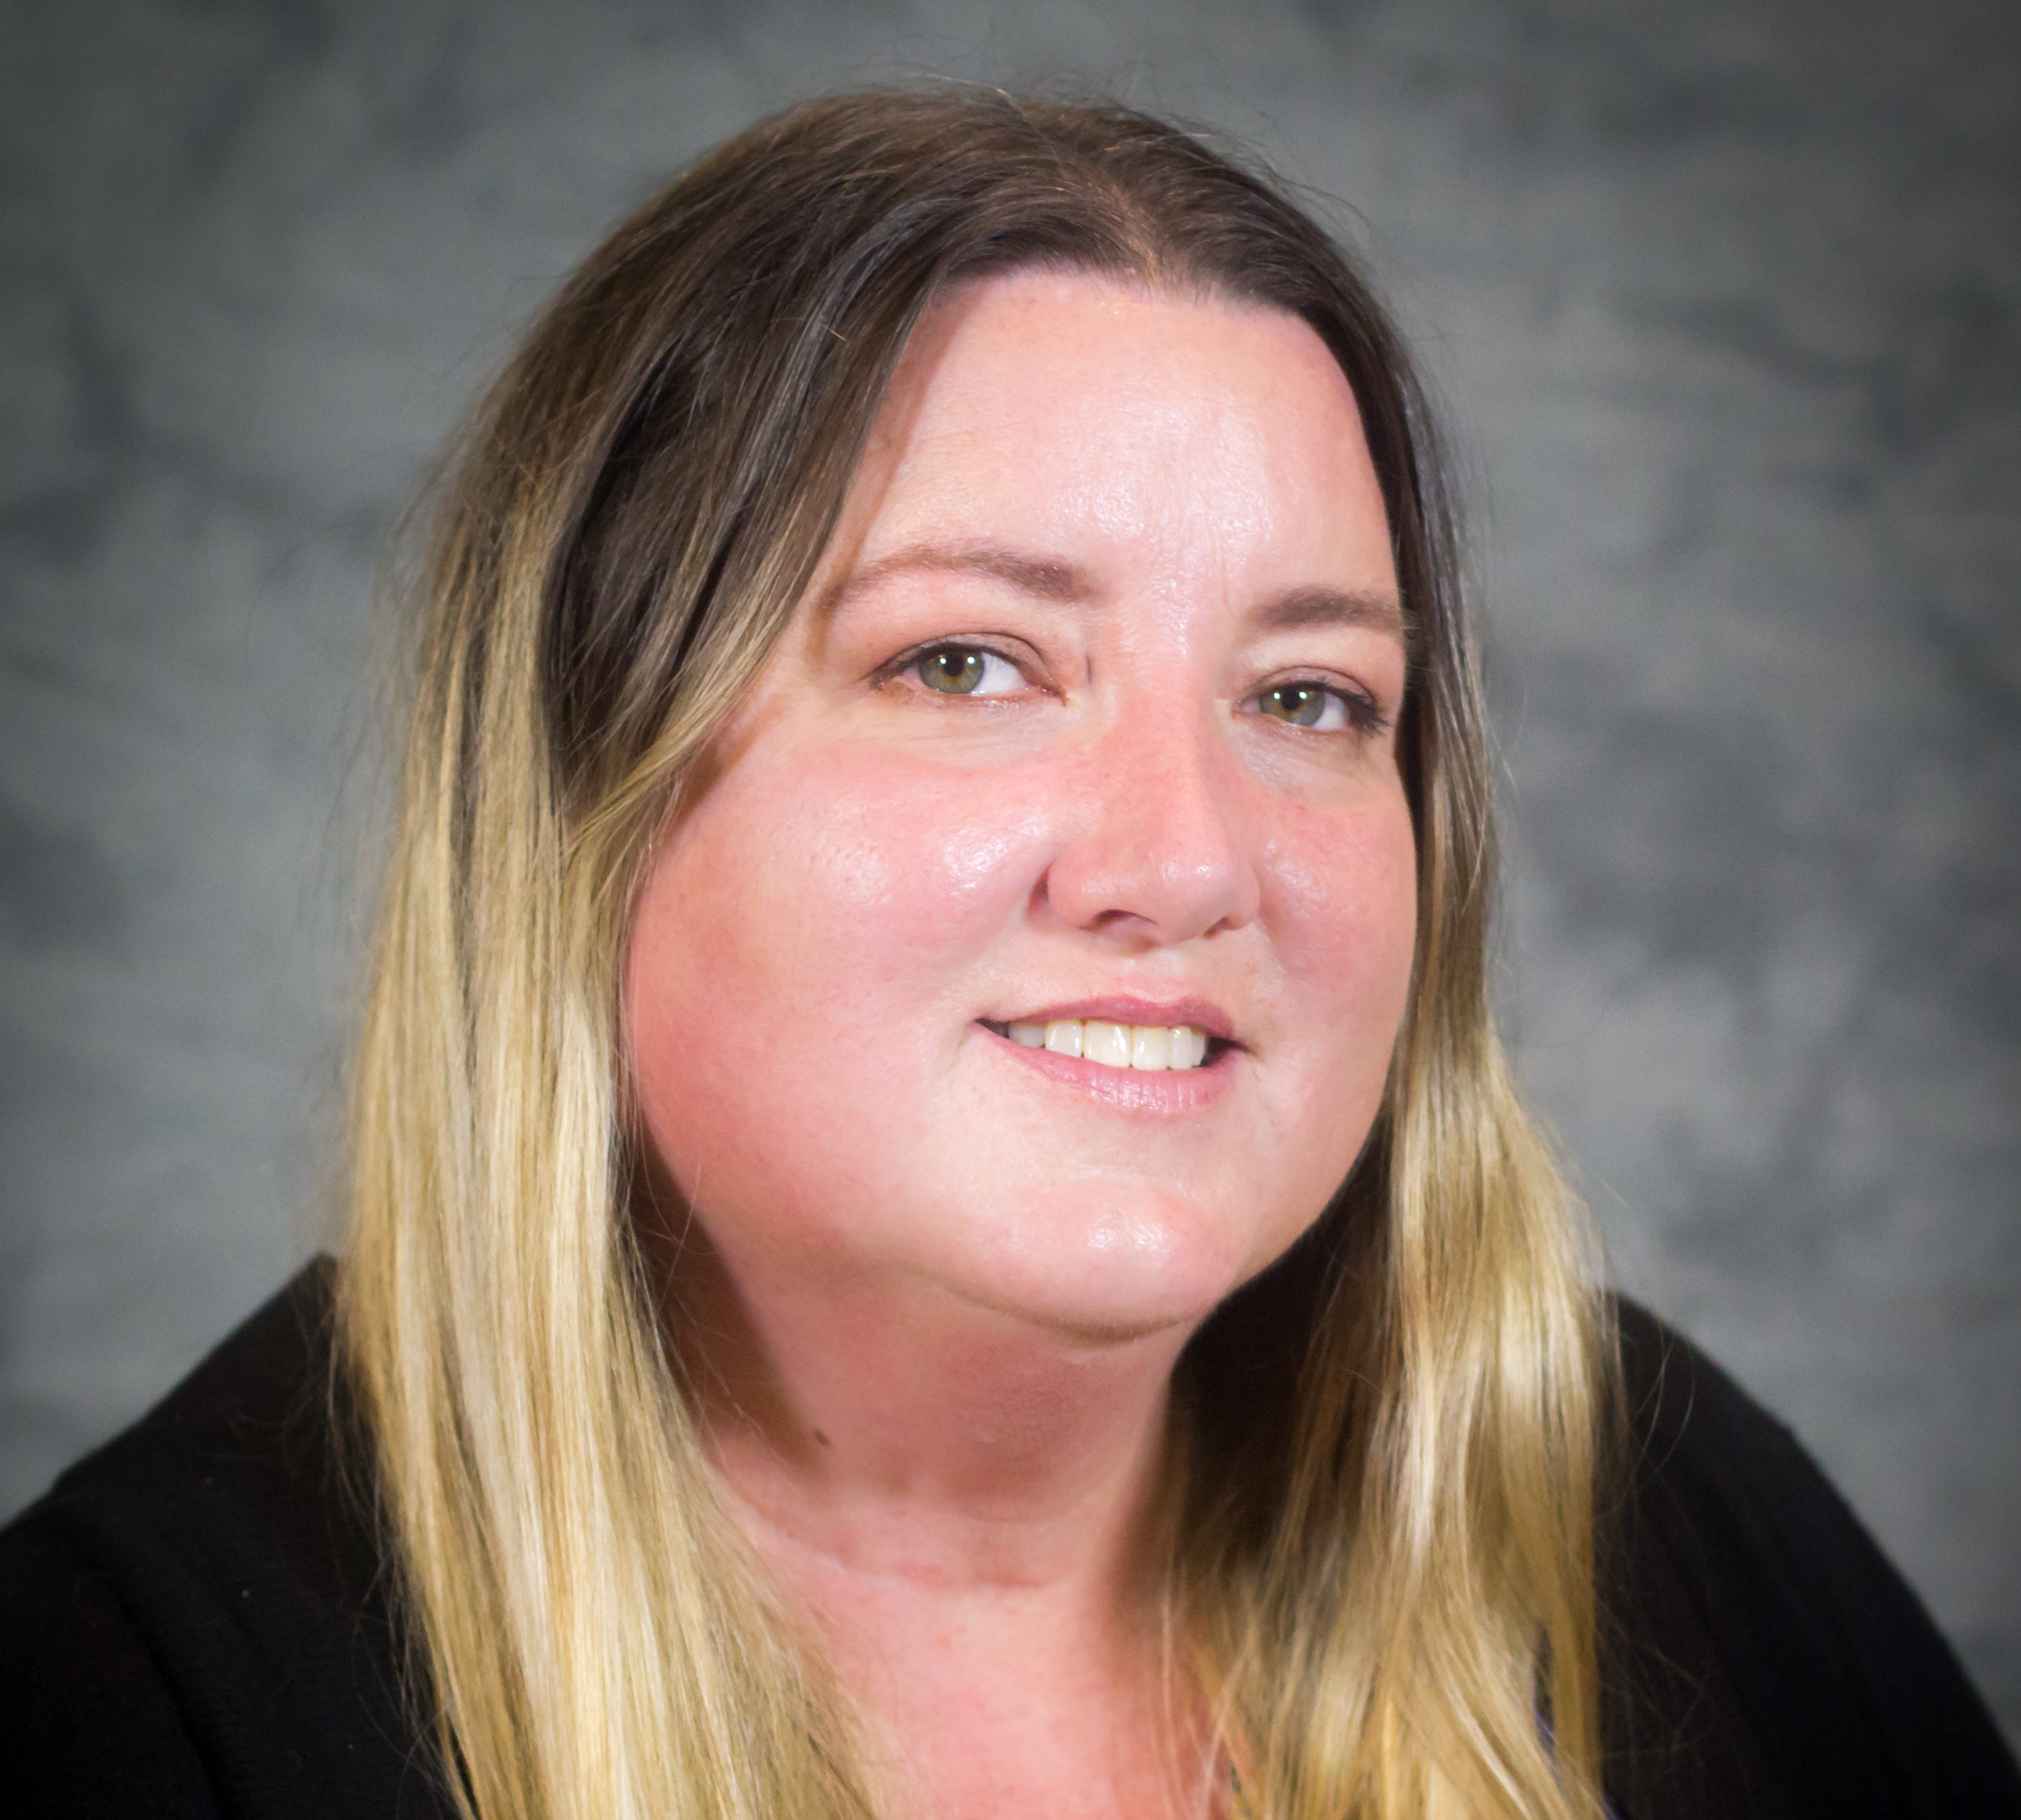
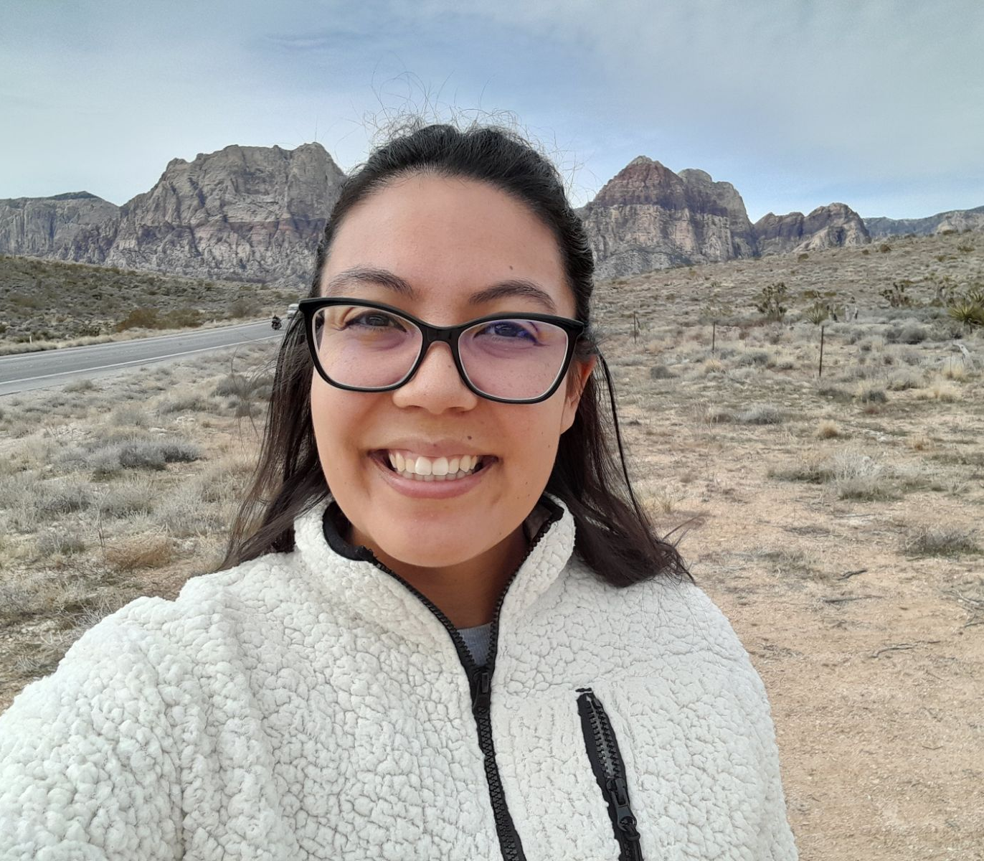
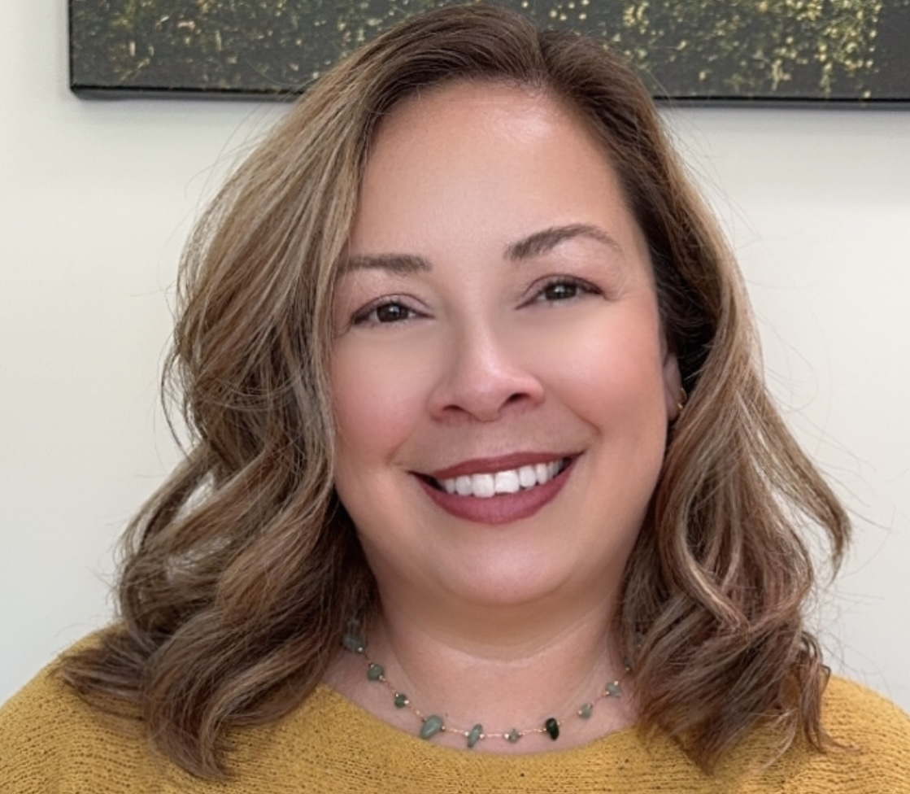
Meet the Team
Tracey Rossine Environmental Programs Manager
Solishia Andico Environmental Health Administrator
Dana Garza Wastewater Management Program Specialist
Notes:
(YB) Our Environmental Health team consists of Tracey Rossine, our Environmental Programs Manager, Solishia Andico, our Environmental Health Administrator, and Dana Garza, our new Wastewater Management Program Specialist. Now, I’ll pass the presentation to Solishia.

Slide 5
Regulatory Framework Overview
Notes:
(SA) Thank you, Yolanda. The first item I’ll go over today is a review of our regulatory framework.

Slide 6
Overview
Codes and Standards
Local Agency Management Plan
Malibu Municipal Code
LA County Plumbing Code
Local Coastal Plan / Local Implementation Plan
Malibu OWTS Manual
2000
AB 885 mandates OWTS standards
2012
State Water Board adopts OWTS Policy
2018
Malibu LAMP manages Tier 2
Notes:
In 2000, Assembly Bill 885 was passed in California that required the State Water Resources Control Board to adopt regulations or standards for the permitting and operation of Onsite Wastewater Treatment Systems. These new standards were adopted by the SWRCB in 2012 and became effective in 2013 as the Water Quality Control Policy for Siting, Design, Operation, and Maintenance of Onsite Wastewater Treatment Systems, also referred to as the “OWTS Policy”. This Policy contains five categories, Tiers 0 through Tier 4, for OWTS administration with different requirements at each tier. Now, the City works off of the 2018 local agency management plan (or LAMP) to manage Tier 2 new or replacement OWTS. Additional codes that the City utilizes include the Malibu Municipal Code, LA County Plumbing Code, LCP – LIP, and the OWTS Manual. We expect you, as the City of Malibu OWTS Practitioners, to be well-versed in these codes and regulations as it relates to your work.
Reference:
• Tier 0 – Existing OWTS that are not failing or contributing to impairment of surface water
• Tier 1 – Low risk new or replacement OWTS where there is not an approved LAMP
• Tier 2 – Local Agency Management Program (LAMP) for New or Replacement OWTS allows the local agencies with approval from the Regional Water Board to develop equivalent requirements to achieve the same Policy purpose
• Tier 3 – Impaired Areas to cover existing, new, and replacement OWTS within 600 feet of water bodies impaired for pathogens or nitrogen per the State
• Tier 4 – OWTS Requiring Corrective Action because they are either failing or at the point when an OWTS fails

Slide 7
OWTS Practitioner Requirements
Notes:
Early this year, there was a big effort to bring certifications of our OWTS Practitioners into compliance. We appreciate your time and coordination in getting your certificates renewed. As a refresher, we are going to go over the requirements for each Practitioner type. Keep this information in mind as you work towards your certificate renewals.

Slide 8
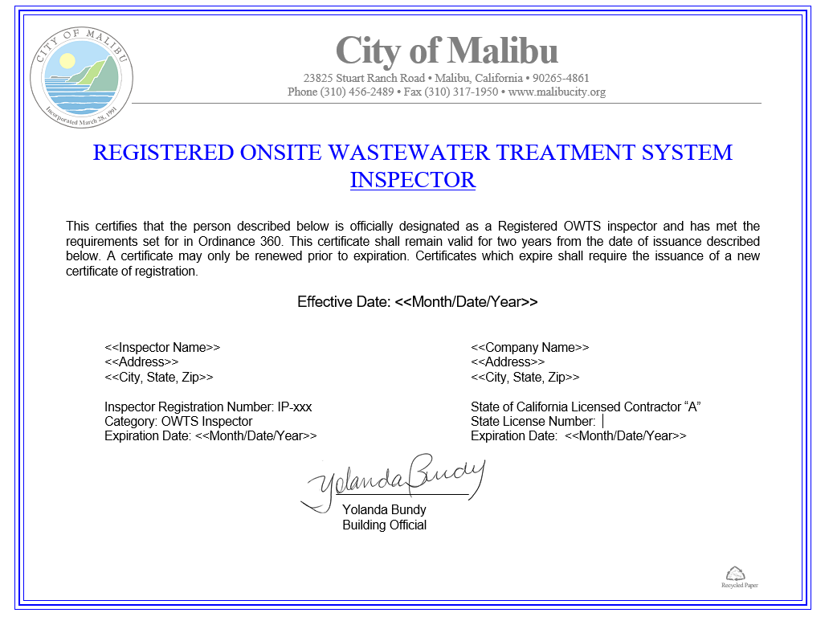
Requirements
It is unlawful for any person to work on OWTS within the city of Malibu without first obtaining a certificate from the City (MMC 5.38)
Notes:
First, it is important to note that under Malibu Municipal Code Chapter 5.38, it is unlawful for any person to work on OWTS within the city of Malibu without first obtaining a certificate from the City. We will go over the requirements for each OWTS practitioner type.

Slide 9
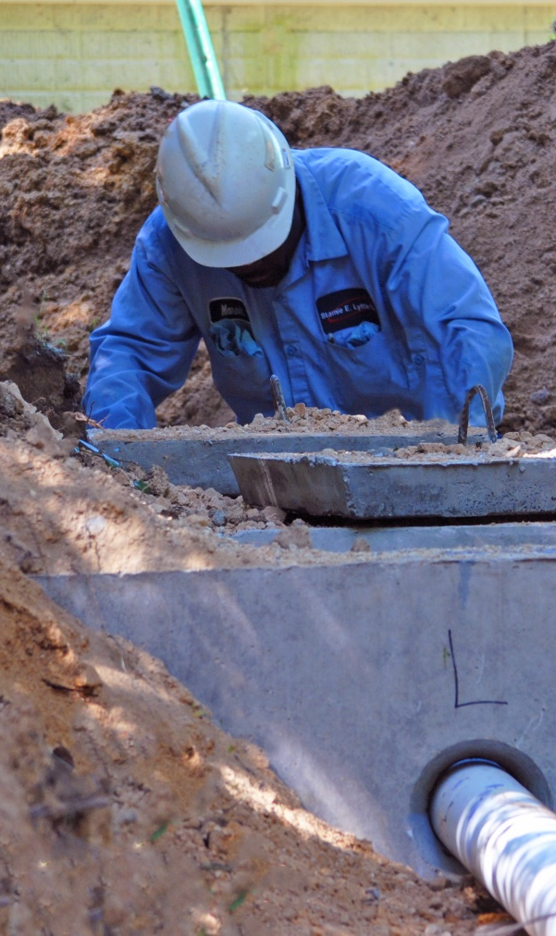
Installer Requirements
Exam
Class A or Specialty C-42 license
2-years experience installing OWTS
Total 8 hours of CEUs:
4 hours before renewal
4 hours when active
Notes:
What are the specific requirements for installers? For newly registered installers or those re-registering once their certificate has lapsed, the City requires a written or field exam demonstrating knowledge of OWTS principles and rules, regulations, laws, and ordinances affecting public health and safety. The exam can be administered by the city or a third-party entity that is approved by the city. Next, an installer must have a Class A or C-42 California contractor’s license, per the CA Business and Professions Code. You must also demonstrate at least 2 years of experience installing septic systems.
**IMPORTANT: In order to renew your City-Registered OWTS Installer certificate, you’ll need to demonstrate a minimum of 4 hours of educational courses approved by the City prior to your certificate expiring. In total, 8 hours of required class time may be averaged over two consecutive years, and a certificate of course completion must be sent over by the instructor, sponsor, or institution of the course. Simply speaking, your OWTS installer certification is active for two years. You’ll need to show 4 hours to CEUs right before renewal, and complete the remaining 4 hours the next year.

Slide 10

Designer Requirements
California PE, PG, REHS
Exam
Training program or 2-years with Designer
Total 16 hours of CEUs:
8 hours before renewal
8 hours when active
Provisional: 2-years experience
Full Registration: 5+ AOWTS designs
Notes:
Next, let’s look into the requirements to be a Designer. You must be either a California-registered civil engineer, professional geologist, or environmental health specialist and submit proof of licensing. We have received a few applications from out-of-state professionals but cannot approve them since they are not registered in California. Next, like the Installers, a designer must complete a written or field exam related to designing OWTS administered by the City or an approved 3rd party. You’ll need to complete a training program related to OWTS design, OR document 2-years of experience working with a City-Registered Designer.
**IMPORTANT: In order to renew your City-Registered OWTS Designer certificate, you’ll need to demonstrate a minimum of 8 hours of educational courses approved by the City prior to your certificate expiring. In total, 16 hours of required class time may be averaged over two consecutive years, and a certificate of course completion must be sent over.
If you’re a new Designer, you can get provisional registration by showing 2-years of experience actively designing advanced OWTS under a City-registered Designer or PE. To get fully registered, you will need to submit 5 or more advanced OWTS designs, and oversee construction of these systems that demonstrate your competency to the City.

Slide 11
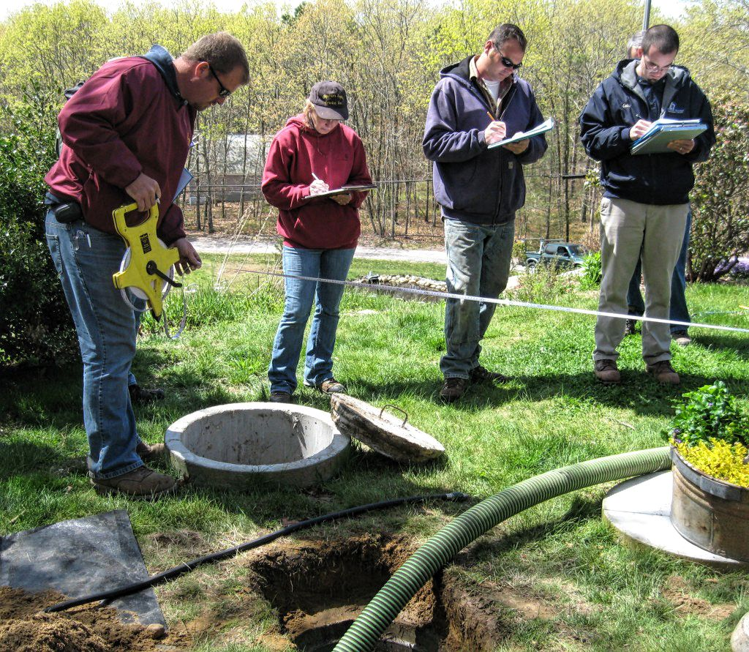
Operation, Monitoring, and Maintenance Specialist Requirements
Notify City in 15 days
Exam
2-years experience or reference letter
Total 16 hours of CEUs:
8 hours before renewal
8 hours when active
Notes:
Next are the registered Operation, Monitoring, and Maintenance Specialists, or OM&M. Each time monitoring, maintenance, or operations have been done, the City must be notified in writing within 15 days. If you are terminating service, provide notification to the City within 15 days. We are receiving these notices from just one company. These notifications are important so we have a record of the OWTS OM&M on file in case something happens and know who to contact.
For newly registered OM&M or those re-registering when the certificate has lapsed, we need a written or field exam demonstrating knowledge of OWTS principles administered by the city or a third-party entity approved by the city. You will also need to demonstrate 2-years of experience by either (1) providing operational oversight and maintenance of advanced OWTS within the city evidenced by maintenance contracts, (2) working with a registered OM&M, (3) working as a registered Designer, or (4) provide a reference letter from a recognized manufacturer of supplemental treatment system equipment attesting to your ability to operate and maintain advanced OWTS.

Slide 12
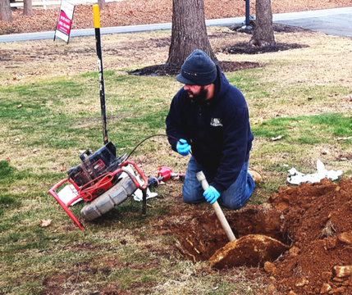
Inspector Requirements
CEG, GE, PE, REHS, or Class A or Specialty C-42 license
OWTS inspection training
Exam
Total 8 hours of CEUs:
4 hours before renewal
4 hours when active
Notes:
To be a City-Registered OWTS Inspector, you must hold a license as either a California-registered certified engineering geologist, geotechnical engineer, civil engineer, environmental health specialist, or licensed contractor with an A or C-42 license. New inspectors or those re-registering must attend an OWTS inspection training with the City to understand how to complete the OWTS inspection form and City’s Guidelines for the Inspection of OWTS.”
**IMPORTANT: In order to renew your City-Registered OWTS Installer certificate, you’ll need to demonstrate a minimum of 4 hours of educational courses approved by the City prior to your certificate expiring. In total, 8 hours of required class time may be averaged over two consecutive years, and a certificate of course completion must be sent over by the instructor, sponsor, or institution of the course. Simply speaking, your OWTS installer certification is active for two years. You’ll need to show 4 hours to CEUs right before renewal, and complete the remaining 4 hours the next year.

Slide 13

OWTS Practitioner Certificate
Notes:
The City can (space bar) suspend a certificate for up to 90 days. The certificate would be suspended due to incompetency, negligence, misrepresentation, or failure to comply with requirements in MMC 5.38.
Your certificate could be revoked for up to 1 year for serious or repeated violations of any of the requirements of MMC 5.38. If your certificate has been revoked, then you cannot reapply until 1 year from the revocation date.

Slide 14
Scenarios
John has designed OWTS systems for years. Now, he is eager to shift gears, grab a shovel, dig a hole, and install his first septic tank. Can he qualify as a City-Registered OWTS Installer?
No, John doesn’t have 2-years of experience installing OWTS, and we do not know if he has the required Class A or Specialty C-42 license.
Notes:
OK, now that we have gone through the requirements to be a City-registered OWTS practitioner, let’s run through a few scenarios to determine if these people are qualified. For this first scenario (read screen).

Slide 15
Scenarios
2. Jane has designed conventional OWTS in Colorado for years. She just moved to Los Angeles and is ready to design OWTS in Malibu. Can she qualify as a City-Registered OWTS Designer?
No, Jane is licensed in Colorado, but not California. Also, Jane only has experience designing conventional OWTS, and does not have experience with advanced OWTS.
Notes:
(read screen)

Slide 16
Scenarios
3. Zach has his C-42 contractors license, took the 8-hour NAWT training and passed the exam, and has installed OWTS for 2+ years. Can he qualify as a City-Registered OWTS Installer?
Yes, Zach meets all qualifications to be a City-Registered OWTS Installer, and will remember to submit his renewal application before the 2-year expiration date.
Notes:
(read screen)

Slide 17
OWTS Requirements
Notes:
Great, now for the next topic, we are going to highlight requirements related to new and existing OWTS and new construction projects.

Slide 18
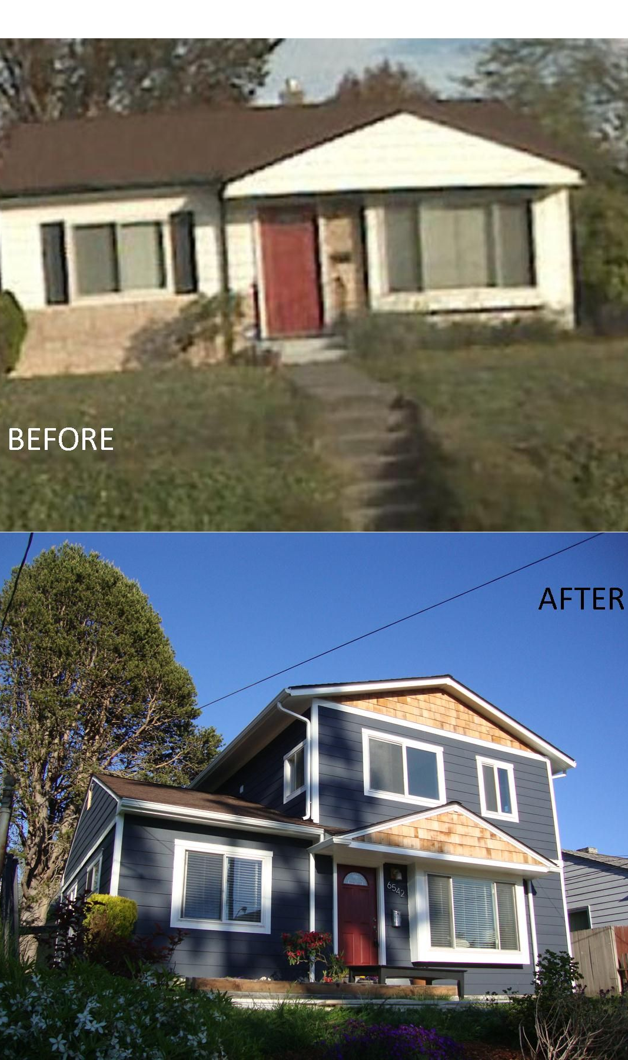
When is a New OWTS Required?
Increasing flow (bedrooms, drainage fixture units)
OWTS had 1 replacement already
Newly constructed / renovated commercial or multifamily
Notes:
To start, let’s look at different scenarios that could trigger installing a new OWTS. First, a new OWTS must be installed when the property is increasing flow by adding bedrooms or drainage fixture units. Secondly, if a property already had one replacement to their OWTS and now requires another repair, then a new system is required. We’re seeing properties that had a septic tank replacement in the past, and now their pits are failing and request installing the futures. This would count as 2 repairs, and therefore requires an application for a new advanced OWTS.
This last item is important because it has come up a few times. Designers, when a commercial or multifamily property is newly constructed or renovated, a new advanced OWTS is required.

Slide 19
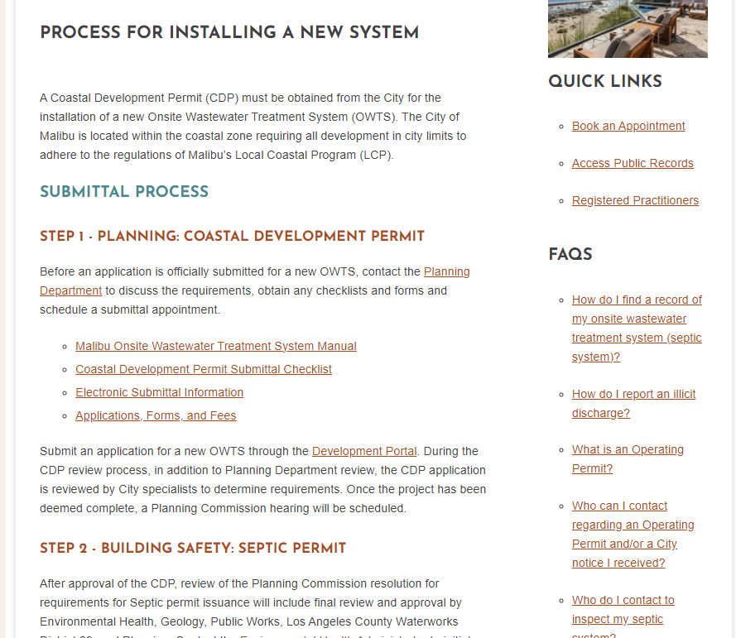
New OWTS Procedures
MMC 15.40
MMC 15.42
MMC 15.44
OWTS Manual
Statewide OWTS Policy
Notes:
If you’re putting in a new OWTS, the requirements are listed on our website at MalibuCity.org/nowts. We won’t dive too much into this as the Designers in this room are well-versed in the submittal process.
I just want to highlight that the main codes that should be reviewed during the design process are listed here. This includes the Malibu Municipal Code Chapter 15.40, 15.42, 15.44, the City’s OWTS Manual, and the Statewide OWTS Policy.

Slide 20
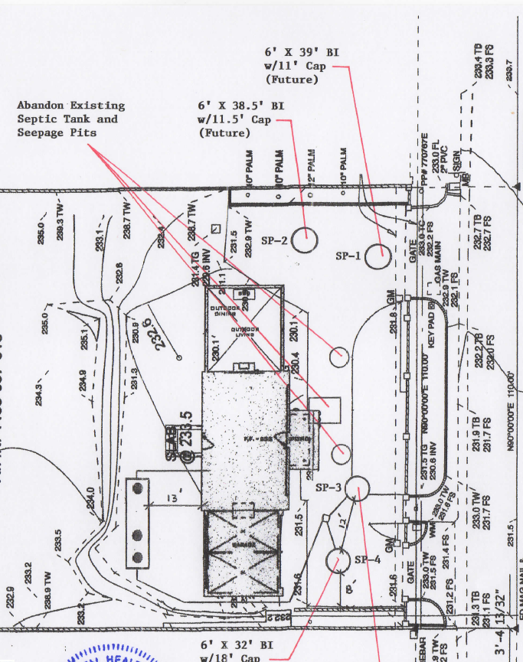
OWTS Plans
Show existing OWTS that will be abandoned
Show all components of OWTS (pump station?)
Show dimensions
Approval expires in 1 year
Notes:
Here’s an example of a new OWTS plan that was previously reviewed. To avoid getting these corrections in your next submittals, we are going to outline some of the corrections we are always issuing. For one, show the existing septic system that is going to be abandoned, and clearly label it on the plans. This helps us issue the OWTS abandonment permit, and helps the field team locate the system that needs to be abandoned. Next, show all components of the new OWTS that you’re designing, including the lines of connection and if there’s going to be a pump station. A few septic projects have been stopped onsite because the elevation change required a pump station, but there weren’t any on the plans, so the project went back to Planning for re-review. Let’s avoid the delay by showing the pump station on the plans if there’s going to be an elevation change and gravity-fed is impossible.
Lastly, the Environmental Health approval is valid for 1 year. We may grant 2 extensions up to 180 days, at the discretion of the Administrator and Building Official. It is pertinent to pull permits within this timeframe, otherwise the project may expire and require resubmittal and review.

Slide 21
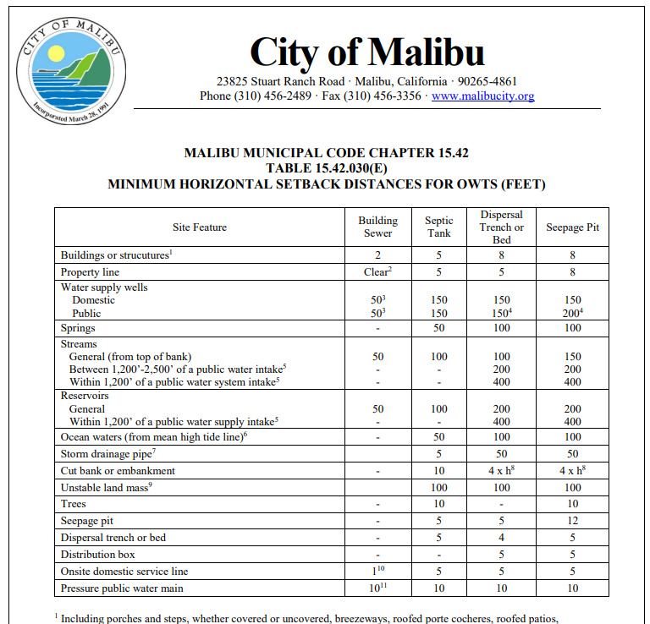
OWTS Setbacks
Notes:
One issue coming up frequently are the OWTS setbacks. This table shows the horizontal distance that must be met between different site features and OWTS components. We are going to highlight a few that have been coming up.
(space) First are setbacks to the property line. A septic tank and dispersal trench or bed must be 5’ away from the property line, and a seepage pit must be 8’ away.
(space) Next, we need to maintain setbacks to all trees, not just protected trees. This is to prevent root infestation to the OWTS. Keep 10’ away between trees to tanks or pits.
(space) Lastly, streams must be 100’ from tanks and dispersal beds, and 150’ away from seepage pits.
When you’re submitting, it’s helpful to clearly draw in the distance between the OWTS component to the closest site features to show that the setbacks are being met. Add in a bar scale and north arrow to your plans, too.

Slide 22
New Construction
Notes:
Next, let’s discuss the installation and construction of septic systems. We are going to highlight some issues and situations that have come up this year about this topic.

Slide 23
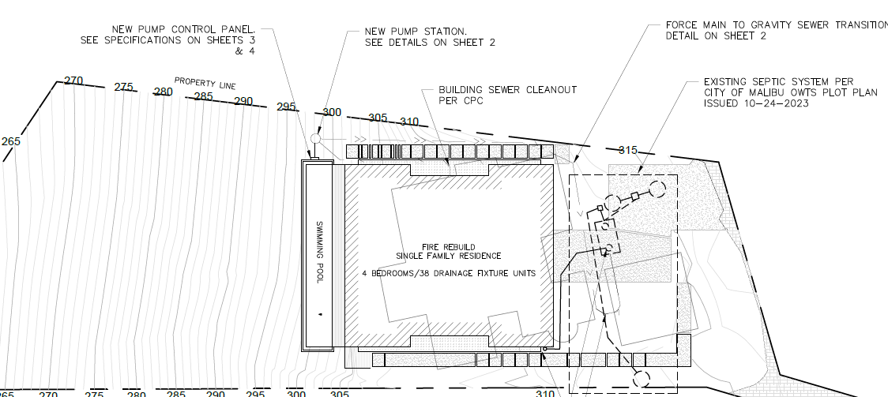
Pump Station
Notes:
One topic that has come up a few times this year is the addition of a pump station after the new OWTS plans or construction plans have been reviewed and the permit has been issued. Once in the field, it becomes obvious that the waste from the residence will need to be pumped up to the tank. However, it’s not always obvious on paper. When you’re designing a new septic system or working with an old system, our request is that you look at the elevations and contours to determine if a pump station is required.
For example, in this plan here, the pump station is being installed around elevation 297 because the tank is at elevation of about 315. That’s a lot of vertical gain to travel.
It is much easier to just add the pump station during the plan review process. If it is proposed after the permits have been issued, then a whole new Planning project must be submitted. Let’s save time by looking at the survey, location of the structures versus the OWTS, and determining if a pump station will be required from the get-go.

Slide 24
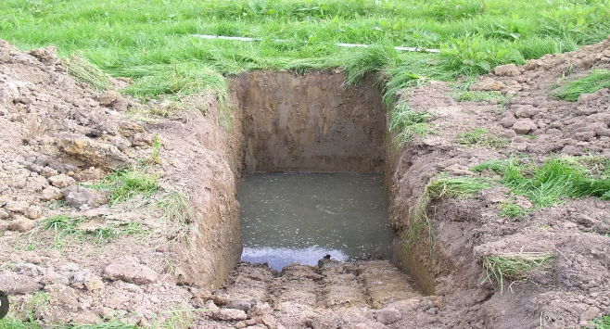
High Groundwater
Work with your geologist
Discuss alternatives with City
Notes:
With the heavy rains of the last couple of winters, people are encountering groundwater at higher levels than they’ve ever seen before. For example, we approved a plan for seepage pits at 51’, but they had to revise the pit depth because groundwater was encountered at 37’ once they started digging earlier this year. When you run into this situation, our first piece of advice is to work with the Project’s Geologist and get their input. Then, come into the City or send an email to me proposing your alternative design ideas.
If the design of the OWTS requires changes, the update submittal will require all standard OWTS documents, including the plans, update design report, update percolation testing, and update supporting geology report for review by Environmental Health and Geology.

Slide 25

OWTS In-Field Changes
“Any change in the OWTS plans after the issuance of an OWTS construction permit must be approved by the administrative authority before being implemented. Failure to obtain approval from the administrative authority will invalidate the permit.” (MMC 15.40.150)
Notes:
If you’re installing the OWTS and notice that an in-field change is required, like adding a pump station or moving a component, notify Environmental Health as soon as possible. The Malibu Municipal Code states that “Any change in the OWTS plans after the issuance of an OWTS construction permit must be approved by the administrative authority before being implemented. Failure to obtain approval from the administrative authority will invalidate the permit.”
Come into counter hours with a reference plan to discuss the changes, or send me an email. Environmental Health will require review, and other departments may need to review the changes or open a new Planning project, depending on the scope. We know changes are urgent while in construction, so notify us as soon as possible so we can review it quickly.

Slide 26
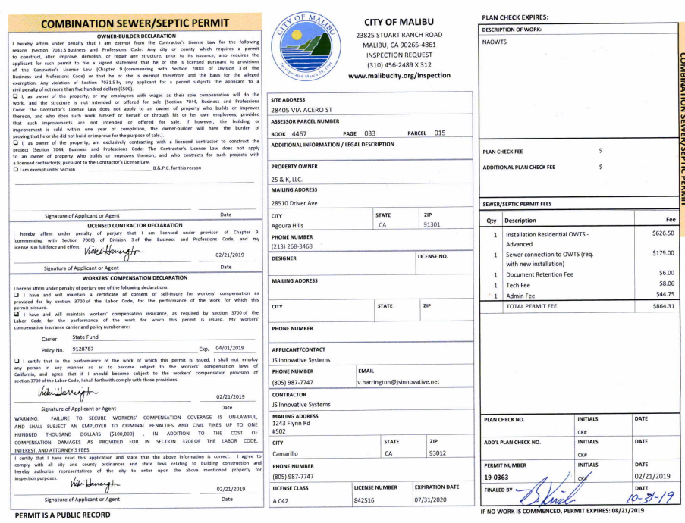
Final Permits
City-Registered OWTS Installer = Applicant
Schedule inspections
Final septic permit
Statement of Completion to City Inspector
Issue Operating Permit
Notes:
Let’s talk about finalling septic permits. The City-registered Installer is the applicant who will pull the SEPTIC permit and schedule inspections with the City. It’s the applicant’s duty to ensure the construction is completed per plan and (space bar) the permit gets finalled and signed-off. A big effort was put into finalling older septic permits this year.

Slide 27
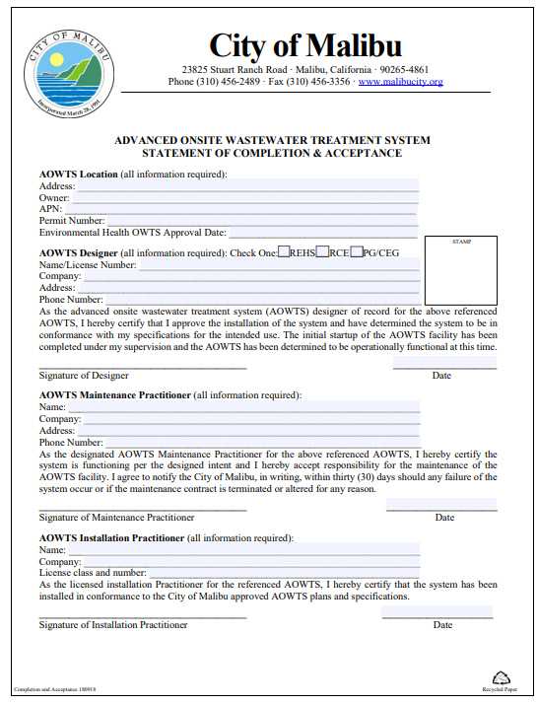
Statement of Completion
City-Registered OWTS Installer = Applicant
Schedule inspections
Final septic permit
Statement of Completion to City Inspector
Issue Operating Permit
Notes:
Then the completed Statement of Completion form signed by all parties (including the Designer, Maintenance Provider, and Installer) must be given to the City Inspector. The Inspector will give the form to Environmental Health in order to issue the Operating Permit.

Slide 28
Maintenance Contract
“I agree to notify the City of Malibu, in writing . . . if the maintenance contract is terminated or altered for any reason.”
Notes:
One item I’d like to bring up on this form for Maintenance Providers is stated here. If a maintenance contract is terminated or altered for any reason, then the City must be notified in writing. This year, I have received maintenance contract termination letters from just one company. Moving forward, please send me an email if the maintenance contract for a property has been terminated. Our team will then send the homeowner a letter asking for the information of the new maintenance provider.

Slide 29
OWTS Maintenance
Notes:
Next, let’s go over the maintenance of the septic systems and City’s processes.

Slide 30
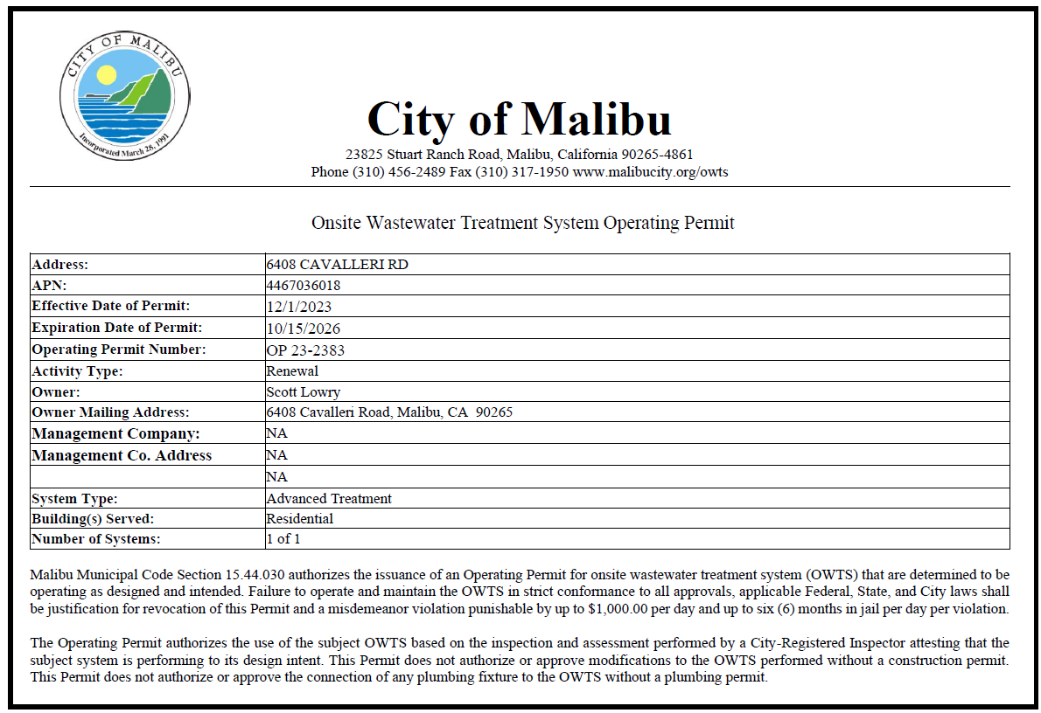
Operating Permits
5 years: Residential, conventional
3 years: Residential, advanced
2 years: Commercial, multi-family, home occupation use
Notes:
The City’s Operating Permit program started in 2008 and requires inspection of septic systems on a regular basis. The OWTS Inspector will inspect the system, submit an Inspection Report to the City, and obtain an Operating Permit. If a property already has an existing system, then an Operating Permit is required when the property is sold, a septic permit is issued for an OWTS repair, or the property wants to obtain a short-term rental permit. For properties with a new septic system, an Operating Permit will be issued once the Statement of Completion form has been received.
Listed here are the timeframes that an Operating Permit is valid. If the property is residential and has a conventional system, then the Operating Permit is valid for 5 years. A residential property with an advanced system has an Operating Permit valid for 3 years. And lastly, commercial and multifamily properties or properties with a home occupation use have Operating Permits valid for 2 years.

Slide 31
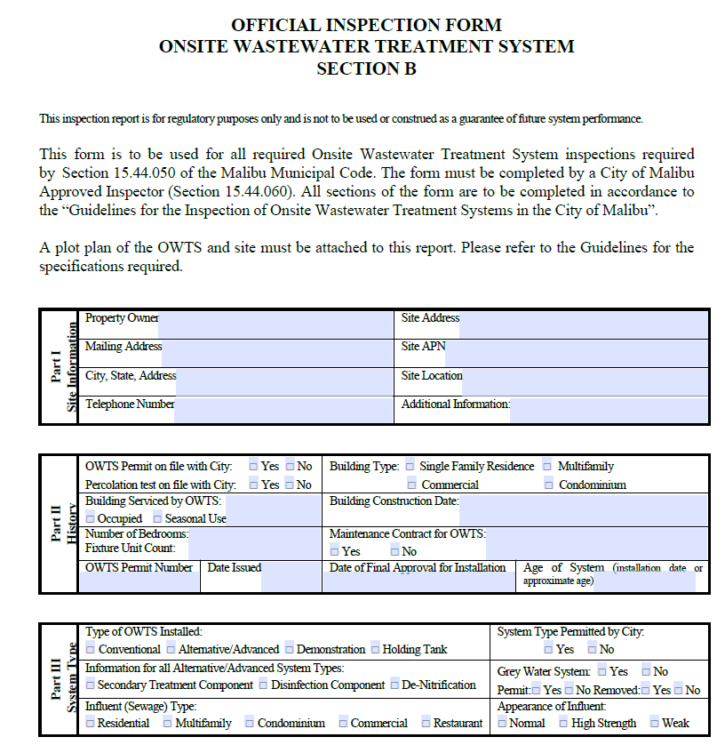
Operating Permits
30-day courtesy notice
Expired notice
Code Enforcement
Coordinate fee
Submit report and communicate with City
Notes:
Our team will send 2 notices. We mail a courtesy notice 30-days before the Operating Permit is expired to the property owner and property’s physical address. Another notice will be sent once the Operating Permit is expired. If the Operating Permit is not obtained, then the property is referred to Code Enforcement and they will post their Notice at the property’s door.
This year, we have focused on bringing expired Operating Permits into compliance. We have sent 10-day notices to properties with very expired Operating Permits requesting for the inspection report and Operating Permit fee to be paid. If you have been contacted to conduct the inspection, feel free to send us an email to let us know in order to avoid the property being sent to Code Enforcement for inaction.
To better help with the process, we have two requests from you: (1) Determine if you or the owner are paying for the Operating permit fee before submitting, then submit the inspection report and fee together. (2) Secondly, properties are being sent to Code Enforcement for inaction, but the owner knows that an Inspector came out. We need your help by submitting the paperwork to us, or emailing us that you did the inspection and will get the report to us soon.

Slide 32
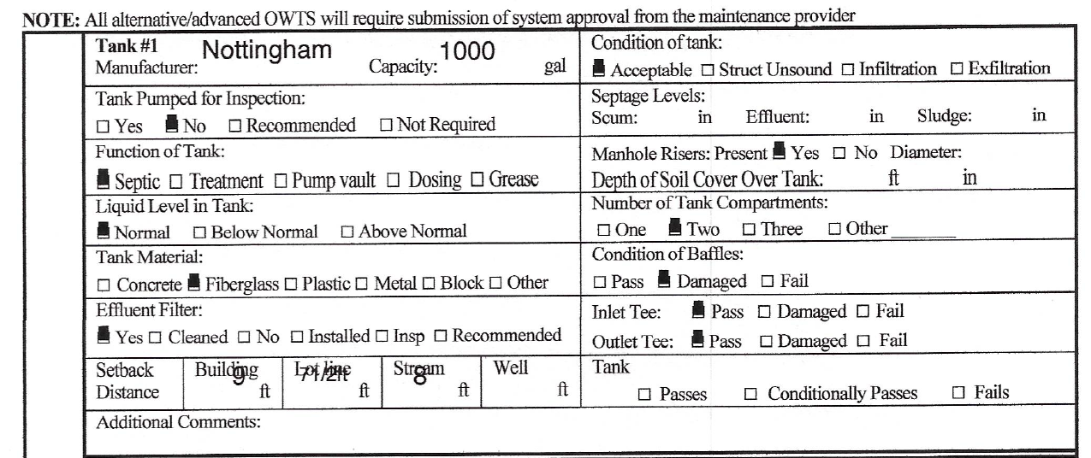
Pass, Conditionally Pass, or Fail
Notes:
Let’s take a look at an inspection report we received. Does this system pass, conditionally pass, or fail? (give a minute to look over) (read through each item)
Interestingly, the Inspector didn’t check if the tank passed, conditionally passed, or failed. As we’ve discussed before, a damaged baffle wall means that the tank has failed.
In this event, what do you tell the homeowner is required for a repair? Does this require a (1) tank replacement, or (2) new septic system?
Raise your hand if you think it requires a tank replacement . . . . Or raise your hand if you think it needs a new septic system.

Slide 33
Options Depend on Situation
Tank Replacement
Single-family residence
No previous replacement
Submit OWTS plot plan
New OWTS
Single-family residence + previous OWTS replacement
Multifamily or Commercial
Enter into a Compliance Agreement
Notes:
Both are possibilities, depending on the situation.
If I got this inspection report for a single-family residence, a tank replacement could be allowed if there have been no previous repairs or replacements to the septic system. You’ll just need to send me an OWTS plot plan for the proposed repair work.
However, a new system could be required for a couple scenarios. If this is a single-family residence that previously had an OWTS repair or replacement, then a new system is required. If this is a multifamily or commercial property, then a new system will be required always – whether there was a previous repair or not. In both scenarios, the owner will need to enter into a Compliance Agreement stating that they will submit an application and install a new septic system.

Slide 34

Frequent Pumping
Pump 3+ times within 180-day period
City to send notice requesting inspection
If repair needed, submit as separate project
Notes:
Next, we will look into frequent pumping. This is defined as a system that is pumped 3 or more times within a 180-day period. When this happens, the City will send a notice to the property requesting an inspection of the OWTS. If the inspection shows that a repair is required, that will be reviewed and processed as a separate project.
This year, we have seen interesting situations with frequent pumping. For example, one homeowner was pumping 6+ times within a couple months because they thought it was better for their system. We also worked with a property that was frequently pumping, and upon inspection discovered that all of the property drains were connected to the septic tank. On the other hand, we also received exemption letters for frequent pumping at a few commercial properties because it was demonstrated that the OWTS was in fine, working condition.

Slide 35
New Codes and Updates
Notes:
Next, let’s go over updates to the code.

Slide 36
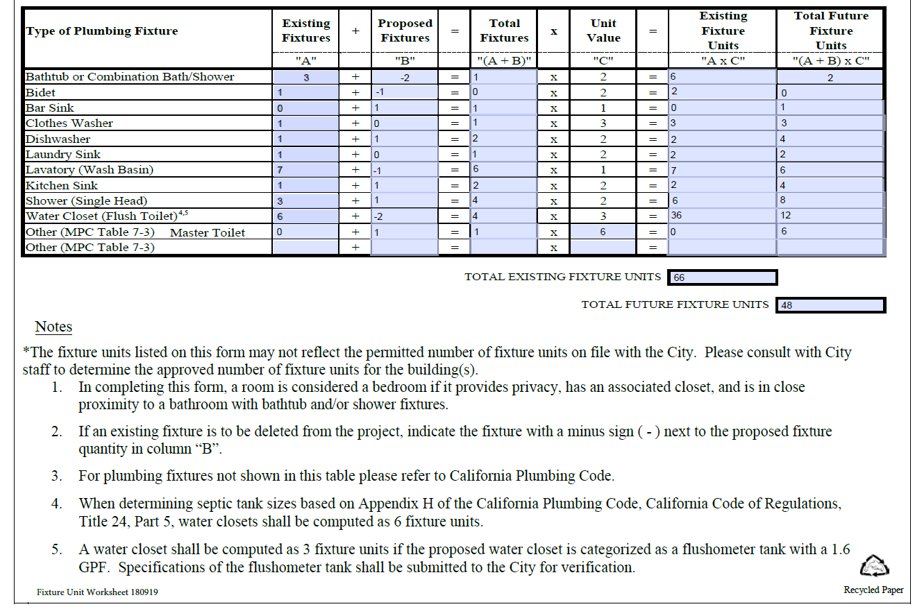
2022 Plumbing Code
Notes:
As an update with the 2022 Plumbing code, toilets or water closets can count as only 3 drainage fixture if it has a flushometer tank, has 1.6 gallon per flush or less, and is ANSI accredited. Previously, all toilets were 6 drainage fixture units. However, they have become more water efficient and can qualify as 3 DFU.

Slide 37
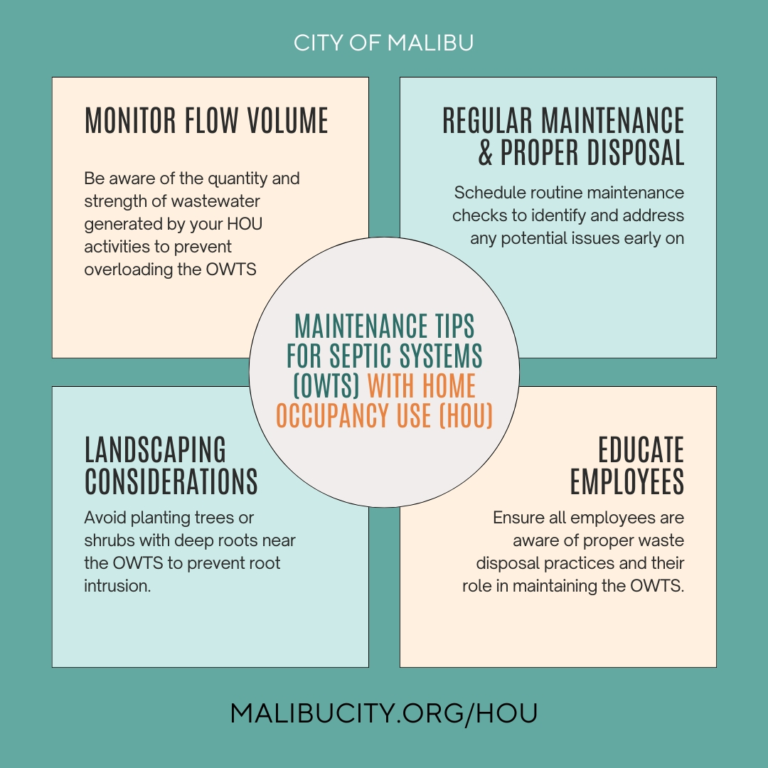
Home Occupation Use
Properties with a home occupation use that increases the quantity and/or strength of flow to the OWTS require the following:
Advanced OWTS
OWTS design report
Operating Permit
Notes:
One of the new codes adopted on June 24th of this year involved amending Malibu Municipal Code Chapters 15.40, 15.42, and 15.44 to require additional OWTS requirements for home occupation uses that place additional strain on the OWTS. This became effective on July 24, 2024.
A homeowner will work with the Planning department to get a permit for a home occupation use, which is defined as any activity in the resident’s home carried out for gain by a resident, as an accessory use. This could include using your home as a hair salon, catering or restaurant, pet grooming, or more. Depending on the type of proposed home occupation use, Environmental Health and the Building Official will determine if this use increases the quantity or strength of flow to the OWTS, and could require an advanced system, update OWTS design report to include the additional flow, and Operating Permit valid for two years.

Slide 38
Best Practices
Notes:
Finally, we will go over a few best practices.

Slide 39


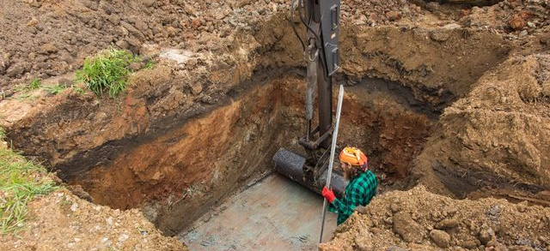
Safety Precautions
Follow OSHA safety standards
Ask a “competent person”: licensed Civil Engineer, Geologist, Environmental Health Speciality, or contractor
Notes:
I’ve received calls from applicants or owners concerned that some Installers were not constructing or installing safely. We need to make sure that everyone’s safety comes first. When you’re out excavating for a new tank or replacing the old one, be sure to follow OSHA regulations for excavations. For example, the top picture does meet OSHA excavation standards. The crew has a hard hat, high vis vest, and appropriate clothing, and the vertical excavation is at a safe height. The picture on the bottom does not meet OSHA standards. The vertical cut is too tall and poses a danger.
Secondly, ask a “competent person,” which is defined as a licensed Civil Engineer, Geologist, Environmental Health Speciality, or contractor familiar with identifying possible hazards, soils, and determining if a protective system is required.

Slide 40

OSHA Guidelines
Notes:
Here’s a graphic from OSHA’s website with a few key tips for trenching and excavation safety.

Slide 41

Summary
Purpose
Meet the Team
Regulatory Framework Overview
OWTS Practitioner Requirements
OWTS Requirements
New Construction
OWTS Maintenance
New Codes and Updates
Best Practices
Q&A
Notes:
(SA) As a recap, . . .

Slide 42
Q & A Session
Solishia Andico, Environmental Health Administrator
Email: sandico@malibucity.org
Phone: 310-456-2489 ext. 292
www.MalibuCity.org/owts

